Slide 1
Online
Virtualizing processors using threads
  Creating and terminating threads
  preemptive scheduling
  threads with separate address spaces
  Layering threads
Suggested reading
  5.5
1

Slide 2
Allocate Thread
thread_id ←ALLOCATE_THREAD (starting_procedure,
address_space_id)
  in address space address_space_id
  begin with starting_procedure

Slide 3
Allocate Thread
Allocate a range of memory in address space id to be used as the stack for procedure calls
selects a processor
Set the processor’s PC to the address starting_procedure in address space id
Set the processor’s SP to the bottom of the allocated stack

Slide 4
Creating and terminating threads
EXIT_THREAD ( ):
  destroy and clean up the calling thread
  When the job is done , call this
DESTROY_THREAD (id):
  In some cases, one thread may need to terminate another thread
  We might want to provide a procedure to destroy a thread

Slide 5
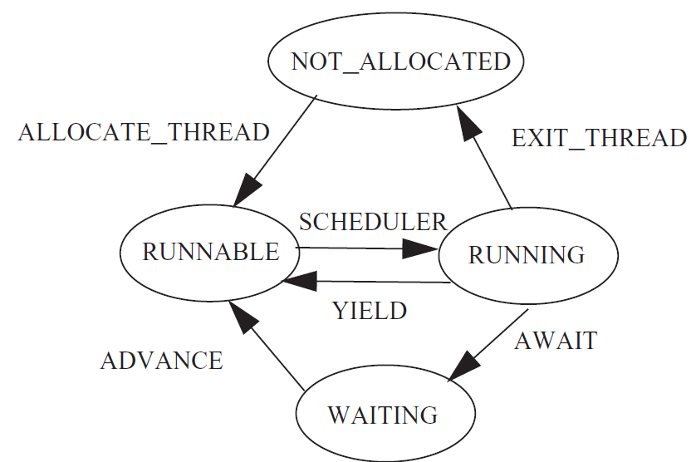
Thread state diagram

Slide 6
Processor-layer threads
When starting the operating system kernel, the kernel creates processor-layer threads
  A separate thread for each processor which runs the procedure SCHEDULER
procedure RUN_PROCESSORS ( )
for each processor do
allocate stack and set up a processor thread
shutdown ← FALSE
SCHEDULER ( )
deallocate processor thread stack
halt processor

Slide 7
procedure send (buffer reference p, message instance msg)
7 acquire (p.buffer_lock)
8 while p.in - p.out >= N do // Wait until there room in the buffer
9 release (p.buffer_lock) // Release lock so that receiver can remove
10 yield ( ) // Let another thread use the processor
11 acquire (p.buffer_lock) // Processor came back, maybe there is room
12 // Wait loop end, go back to test
13 p.message[p.in modulo n] ← msg // Put message in the buffer
14 p.in ← p.in + 1 // Increment in
15 release (p.buffer_lock)

Slide 8
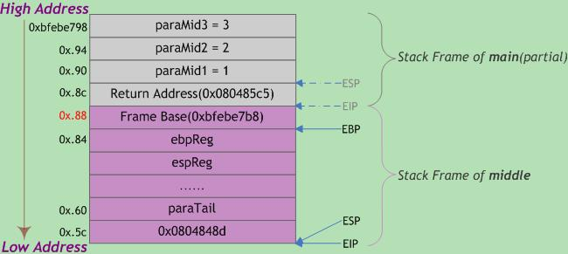

Slide 9
call指令
  在AT&T汇编中，call foo（foo是一个标号）等效于以下汇编指令：
Pushl %eip
movl f, %eip

Slide 10
Leave return
    leave指令
      在AT&T汇编中，leave等效于以下汇编指令：
mov %ebp, %esp
pop %ebp
    ret指令
      在AT&T汇编中，ret等效于以下汇编指令：
popl %eip

Slide 11
https://blog.csdn.net/u010442328/article/details/45936857

Slide 12
Function call
#include<stdio.h>
int main()
{
int s;
s=back(1,2);
printf("s=%d\n",s);
return 0;
}
int back(int a,int b)
{
int x;
x=a+b;
return;
}

Slide 13
main:
pushl %ebp
movl %esp, %ebp
andl $-16, %esp
subl $32, %esp
movl $2, 4(%esp)
movl $1, (%esp)
call back
movl %eax, 28(%esp)
movl $.LC0, %eax
movl 28(%esp), %edx
movl %edx, 4(%esp)
movl %eax, (%esp)
call printf
movl $0, %eax
leave
ret
back:
.LFB0:
pushl %ebp
movl %esp, %ebp
subl $16, %esp
movl 12(%ebp), %eax
movl 8(%ebp), %edx
addl %edx, %eax
movl %eax, -4(%ebp)
leave
ret
.LC0:
.string "s=%d\n"
.text
.globl main
.type main, @function

Slide 14
Creating and terminating threads
1 shared structure processor_table[7] // each processor maintains the following information:
2 integer topstack // value of stack pointer
3 byte reference stack // preallocated stack for this processor
integer thread_id // identity of thread currently running on this processor
-----------------------------------------------------------------------------------------
5 shared structure threadtable[7] // each thread maintains the following information:
6 integer topstack // value of the stack pointer
7 integer state // RUNNABLE, RUNNING, or FREE
8 boolean kill_or_continue // terminate this thread? initialized to CONTINUE
9 byte reference stack // stack for this thread

Slide 15
Creating and terminating threads
10 procedure YIELD ( )
11 ACQUIRE (threadtable_lock)
12 ENTER_PROCESSOR_LAYER (GET_THREAD_ID( ), CPUID)
// See caption below!
13 RELEASE (threadtable_lock)
14 return
15

Slide 16
Processor-layer threads
When starting the operating system, there are two threads on each processor
  Processor layer thread
  User layer thread
The user layer thread
  Is set in thread table
  At the top of stack the address of line 13 (YIELD) is stored
  Next below the top of stack stores the first address of the starting procedure
  The starting procedure is usually a shell or consol

Slide 17
Creating and terminating threads
16 procedure SCHEDULER ( )
17 while shutdown = FALSE do
18 ACQUIRE (threadtable_lock)
19 for i from 0 until 7 do
20 if threadtable[i].state = RUNNABLE then
21 threadtable[i].state ← RUNNING
22 processor_table[CPUID].thread_id ← i
23 EXIT_PROCESSOR_LAYER (CPUID, i )
24 if threadtable[i].kill_or_continue = KILL then
25 threadtable[i].state ← FREE
26 DEALLOCATE(threadtable[i]. stack)
27 threadtable[i]. kill_or_continue = CONTINUE
28 RELEASE (threadtable_lock)
29 return // Go shut down this processor

Slide 18
30 procedure ENTER_PROCESSOR_LAYER (tid, processor)
31 threadtable[tid].state ← RUNNABLE
32 threadtable[tid].topstack ← SP // save state: store yielding’s thread SP
33 SP ← processor_table[processor].topstack // dispatch: load SP of processor thread
34 return
35 procedure EXIT_PROCESSOR_LAYER (processor, tid) // transfers control to line 14
36 processor_table[processor].topstack ← SP // save state: store processor thread’s SP
37 SP ← threadtable[tid].topstack // dispatch: load SP of thread
38 return

Slide 19
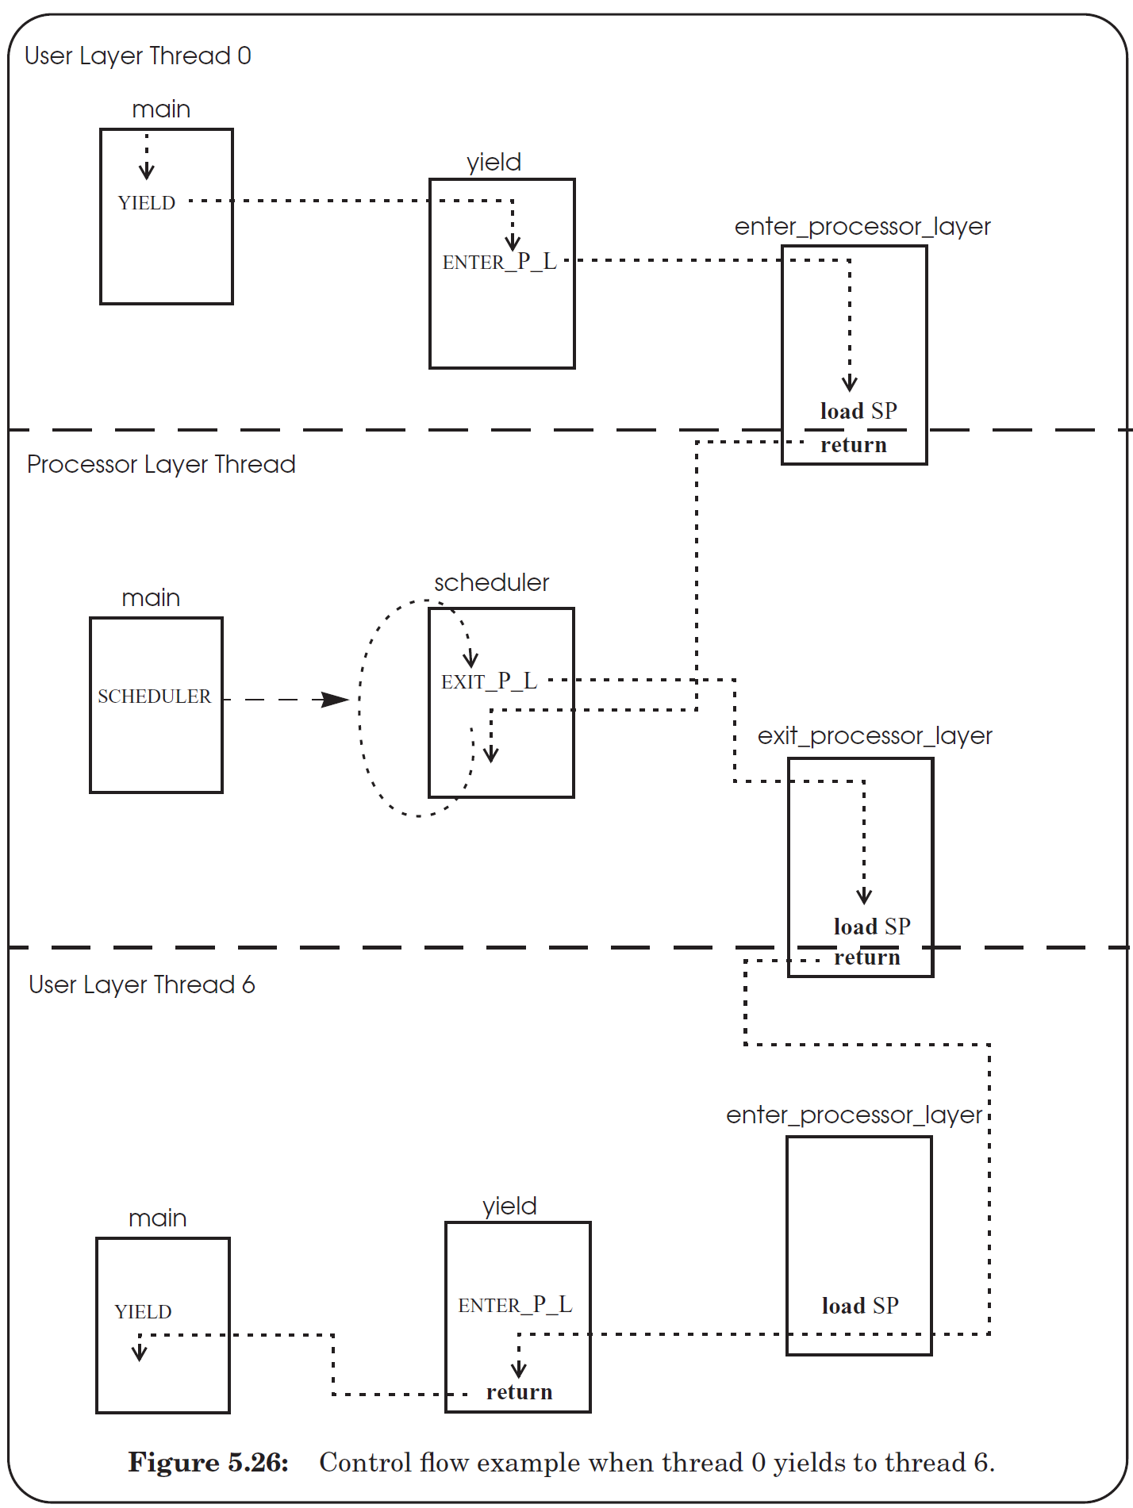

Thread Switching

Slide 20
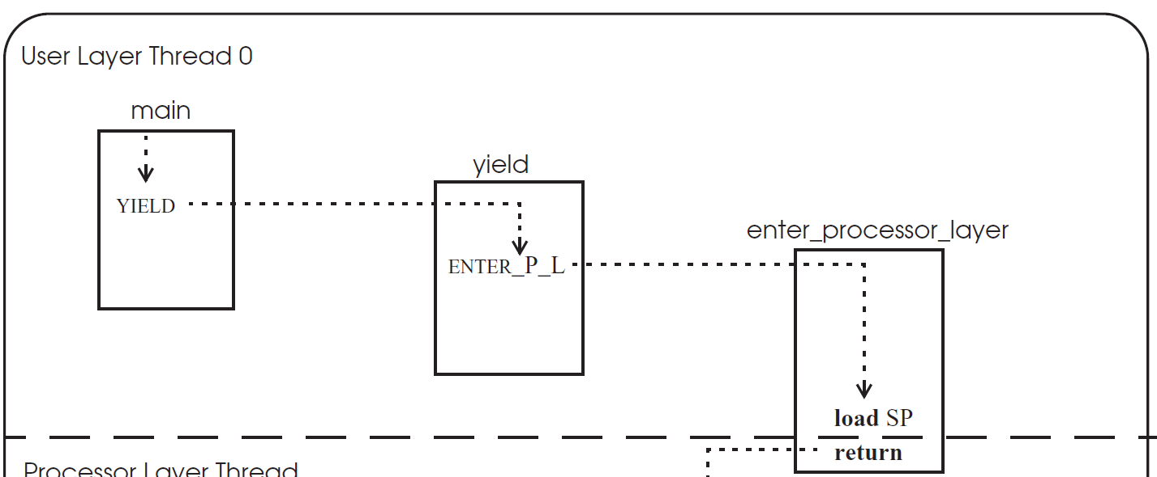
Thread Switching

Slide 21
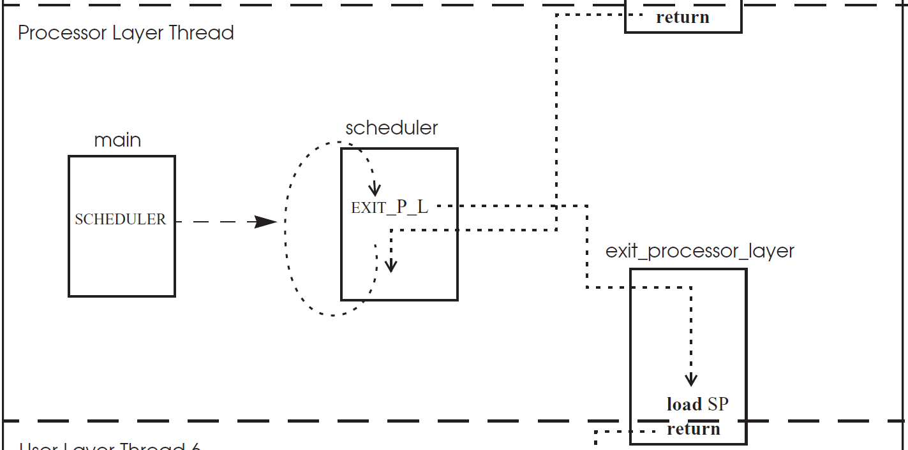
Thread Switching

Slide 22
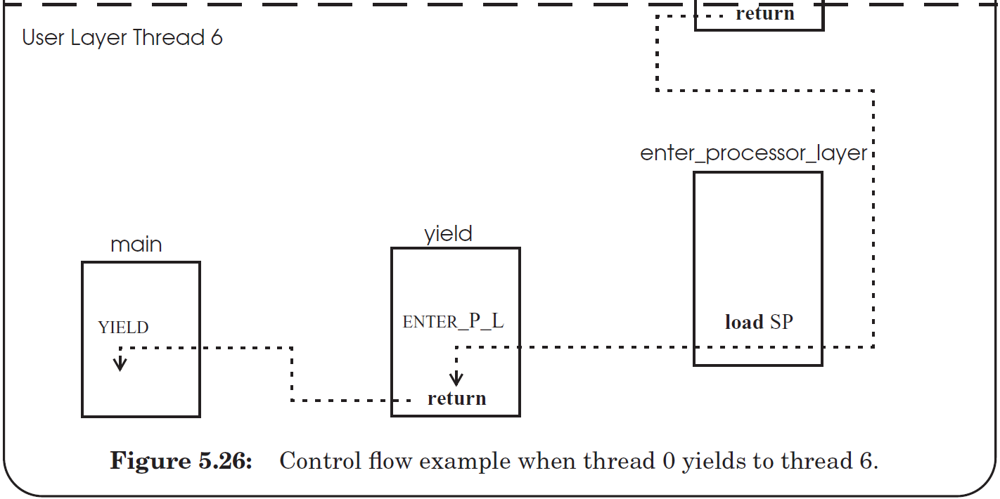
Thread Switching

Slide 23
Revisit ALLOCATE_THREAD
1. allocate space in memory for a new stack;
2. place on the new stack an empty frame containing just a return address and initialize that return address with the address of EXIT_THREAD;
3. place on the stack a second empty frame containing just a return address, and initialize this return address with the address of starting_procedure;
4. find an entry in the thread table that is FREE and initialize that entry for the new thread in the thread table by storing the top of the new stack;
5. set the state of newly-created thread to RUNNABLE.

Slide 24
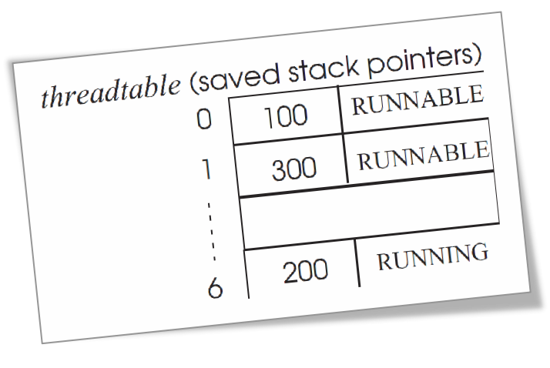
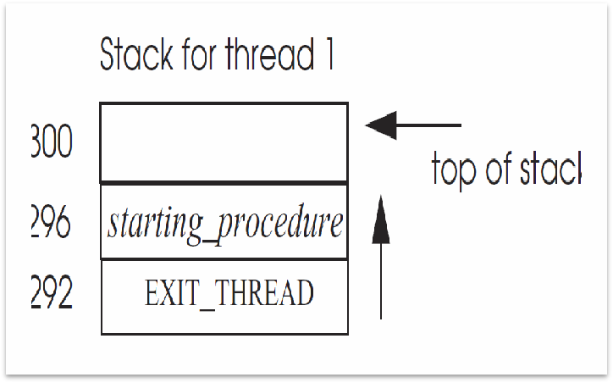
Revisit ALLOCATE_THREAD

Slide 25
Implementing EXIT_THREAD
1 procedure EXIT_THREAD( )
2 ACQUIRE (threadtable_lock)
3 threadtable[tid].kill_or_continue ← KILL
4 ENTER_PROCESSOR_LAYER (GET_THREAD_ID ( ), CPUID)

Slide 26
Implementing DESTROY_THREAD
DESTROY_THREAD
  Only sets the kill_or_continue variable of the target thread to KILL
  and return
the processor thread
  will check this variable
  and release the thread’s resources

Slide 27
nonpreemptive Scheduling
nonpreemptive scheduling
  A thread continues to run until it gives up its processor
cooperative scheduling (cooperative multitasking)
  every thread is supposed to call YIELD periodically

Slide 28
preemptive scheduling
preemptive scheduling
  The thread manager force a thread to give up its processor after a time interval

Slide 29
Implement the preemptive scheduling
Set the interval timer of a clock device
When the timer expires
  the clock triggers an interrupt
  invoke clock interrupt handler, in kernel
  The clock interrupt handler invokes an exception handler which
    runs in the thread layer
    forces the currently running thread to yield.

Slide 30
Implement the preemptive scheduling
An interrupt handler shouldn’t invoke procedures in the thread layer at all, not even when the interrupt pertains to the currently running thread

Slide 31
Implement the preemptive scheduling
Consider a processor that invokes an interrupt handler that calls YIELD
  If the interrupt happens right after the thread on that processor has acquired threadtable_lock in YIELD
  The handler invokes YIELD will try to acquire threadtable_lock again
  It already has been acquired by the interrupted thread
  That thread cannot continue and release the lock

Slide 32
preemptive scheduling （ Concurrent activity ）
Concurrent activity within the processor layer
  the thread manager
  the interrupt handler
The processor may stop processing instructions of a thread at any time and switch to --→
processing interrupt instructions
processor instruction stream
before-or-after
interrupt instruction stream

Slide 33
Implement the preemptive scheduling
When a thread acquires the threadtable_lock,
  It disables interrupts on its processor
  The processor will not switch to an interrupt handler when an interrupt arrives
  Interrupts are delayed until they are enabled again
After the thread released the threadtable_lock
  It is safe to reenable interrupts
  Any pending interrupts will then execute immediately
  It is now safe since no thread on this processor can be inside the thread manager

Slide 34
Thread with it Own Virtual Address Space
The thread manager is aware of the virtual address spaces
  When it switches a processor from one thread to another
  Also switch the address space
  ENTER_PROCESSOR_LAYER saves the contents of the processor’s PMAR (page-map address
  register ) into the threadtable entry of the thread
  EXIT_PROCESSOR_LAYER loads the processor’s PMAR with the value in the threadtable entry of the new thread

Slide 35
Thread with it Own Virtual Address Space
Loading the PMAR adds one significant complication to the thread manager
  starting at the instant that the processor loads a new value into the PMAR
  using the new page table
  The next instruction
    from new virtual address space.

Slide 36
Thread with it Own Virtual Address Space
Map both the instructions and the data of the thread manager into the same set of virtual addresses in every virtual address space
Design hardware that can load the PMAR, SP, and PC as a single before-or-after action,
  return control to the thread in the new virtual address space at the saved location and with the saved stack pointer

Slide 37
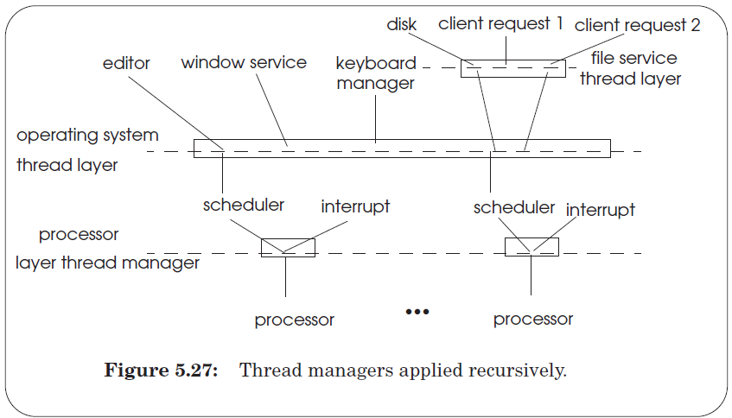
Layering threads

Slide 38
Online
Thread Primitives for Sequence Coordination
  Primitives
  Implementation
  Preemptive scheduling
  Polling, interrupts, sequence coordination
Suggested reading
  5.6

Slide 39
Primitives for Sequence Coordination
Polling
  a thread continually tests a shared variable
WAIT (event_name) is a before-or-after action
  sets this thread’s state to WAITING
  places event_name in the thread table entry for this thread
  yields its processor
NOTIFY (event_name) is a before-or-after action
  looks in the thread table for a thread that is in the state WAITING for event_name
  changes that thread to the RUNNABLE state

Slide 40
Primitives for Sequence Coordination
1 shared structure buffer // A shared bounded buffer
2 message instance message[N] // with a maximum of N messages
3 long integer in initially 0 // Counts number of messages put in the buffer
4 long integer out initially 0 // Counts number of messages taken out of the buffer
5 lock instance buffer_lock initially UNLOCKED // Lock to coordinate sender and receiver
6 event instance room // Event variable to wait until there is room in buffer
7 event instance notempty // Event variable to wait until the buffer is not empty

Slide 41
Primitives for Sequence Coordination
8 procedure SEND2 (buffer reference p, message instance msg)
9 ACQUIRE (p.buffer_lock)
10 while p.in – p.out = N do // Wait until there room in the buffer
11 RELEASE (p.buffer_lock) // Release lock
12 WAIT(p.room) // Release processor
13 ACQUIRE (p.buffer_lock)
14 p.message[p.in modulo N] ← msg
15 if p.in = p.out then NOTIFY(p.notempty) // there is a message
16 p.in ← p.in + 1 // Increment in
17 RELEASE (p.buffer_lock)

Slide 42
Primitives for Sequence Coordination
18 procedure RECEIVE (buffer reference p)
19 ACQUIRE (p.buffer_lock)
20 While p.in = p.out do //Wait until there is a message to receive
21 RELEASE (p.buffer_lock) //Release lock so that sender can add
22 WAIT(p.notempty) // Release processor
23 ACQUIRE (p.buffer_lock)
24 msg ← p.message[p.out modulo N] // Copy item out of buffer
25 if p.in – p.out = N then NOTIFY(p.room) //there is room now
26 p.out ← p.out + 1 // Increment out
27 RELEASE (p.buffer_lock)
28 return msg

Slide 43
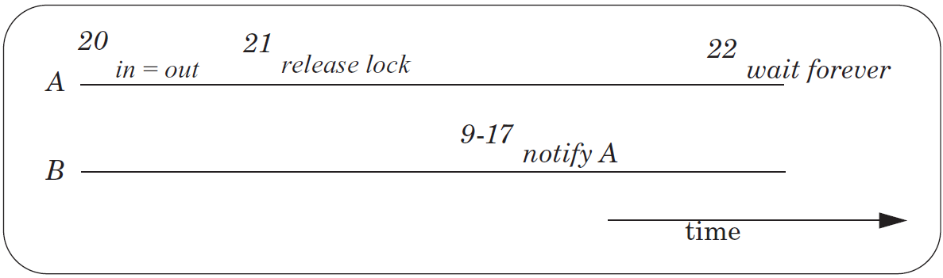
Primitives for Sequence Coordination
How to implement sleep

Slide 44
Primitives for Sequence Coordination
3 operations on the shared buffer state that must be turned into a before-or-after action:
  testing if there is room in the shared buffer, and
  if not, going to sleep until there is room and
  releasing the shared lock so that another thread can make room.
If these 3 operations are not a before-or-after action, then there is the risk of the lost notification problem.

Slide 45
Primitives for Sequence Coordination
The steps we would like to make into an atomic action are
  comparing in and out
  changing the thread table entry from RUNNING to WAITING
The variables in and out are owned by the user threads
The thread table is owned by the thread manager
These are not only separate modules, the thread manager is probably in the kernel

Slide 46
Primitives for Sequence Coordination
The additional thread state
  Can be found in variables
    eventcounts and sequencers
  Must be shared between the application and the thread manager

Slide 47
Primitives for Sequence Coordination
AWAIT (eventcount, value) is a before-or-after action
  Compares eventcount to value
  If eventcount exceeds value
    AWAIT returns to its caller.
  If eventcount is less than or equal to value, AWAIT
    changes the state of the calling thread to WAITING
    places value and the name of eventcount in this thread’s entry in the thread table
    yields its processor

Slide 48
Primitives for Sequence Coordination
ADVANCE (eventcount) is a before-or-after action
  Increments eventcount by one
  Searches the thread table for threads that are waiting on this eventcount.
  For each one it finds,
    if eventcount now exceeds the value for which that thread is waiting
    Changes that thread’s state to RUNNABLE

Slide 49
Primitives for Sequence Coordination
TICKET (sequencer) is a before-or-after action
  returns a non-negative value that increases by one on each call
  Two threads concurrently calling TICKET on the same sequencer
    receive different values
    the ordering of the values returned corresponds to the time ordering of the execution of TICKET

Slide 50
Primitives for Sequence Coordination
READ (eventcount or sequencer) is a before-or-after action
  Returns to the caller the current value of the variable
  Having an explicit READ procedure is to assure before-or-after atomicity for eventcounts and sequencers whose value may grow to be larger than a memory cell

Slide 51
Thread state diagram

Slide 52
A Single Sender and A Single Receiver
1 shared structure buffer
2 message instance message[N]
3 eventcount instance in initially 0
4 eventcount instance out initially 0

Slide 53
AWAIT ---- Single Sender
5 procedure SEND (buffer reference p, message instance msg)
6 AWAIT (p.out , p.in – N) // Wait until there is space in buffer
7 p.message[READ(p.in) modulo N] ← msg // Copy message
ADVANCE (p.in) // Increment in and alert receiver
9 procedure RECEIVE (buffer reference p)
10 AWAIT (p.in, p.out) // Wait till something in buffer
11 msg ← p.message[READ(p.out) modulo N] // Copy message
12 ADVANCE (p.out) // Increment out and Alert sender
13 return msg

Slide 54
Multiple Senders and a Single Receiver
1 shared structure buffer
2 message instance message[N]
3 eventcount instance in initially 0
4 eventcount instance out initially 0
5 sequencer instance sender

Slide 55
Multiple Senders and a Single Receiver
6 procedure SEND (buffer reference p, message instance msg)
7 t ← TICKET (p.sender) // Allocate a buffer slot
8 AWAIT (p.in, t) //Wait till previous slots are filled
9 AWAIT (p.out, READ(p.in) – N) // Wait till there is space in buffer
10 p.message[READ(p.in) modulo N] ← msg // Copy message
11 ADVANCE (p.in) // Increment in and alert receiver

Slide 56
Primitives for Sequence Coordination
shared structure threadtable[7]
integer topstack // value of the stack pointer
integer state // WAITING, RUNNABLE, TERMINATE, NOT_ALLOCATED
eventcount reference event // if waiting, the eventcount we are waiting on
long integer value // if waiting, what value are we waiting for
shared lock instance threadtable_lock // lock to protect entries of threadtable

Slide 57
Primitives for Sequence Coordination
1 structure eventcount
2 long integer count
3 procedure AWAIT (eventcount reference event, value)
4 ACQUIRE (threadtable_lock)
5 id ← GET_THREAD_ID ( )
6 threadtable[id].event ← event
7 threadtable[id].value ← value
8 if event.count ≤ value then threadtable[id].state ← WAITING
9 ENTER_PROCESSOR_LAYER (id, CPUID)
10 RELEASE (threadtable_lock)

Slide 58
Implementing Primitives
1 procedure ADVANCE (eventcount reference event)
2 ACQUIRE (threadtable_lock)
3 event.count ← event.count + 1
4 for i from 0 until 7 do
5 if threadtable[i].state = WAITING and threadtable[i].event = event and
6 event.count > threadtable[i].value then
7 threadtable[i].state ← RUNNABLE
8 RELEASE (threadtable_lock)

Slide 59
Implementing Primitives
1 structure sequencer
2 long integer ticket
3 procedure TICKET (sequencer reference s)
4 ACQUIRE (threadtable_lock)
5 t ← s.ticket
6 s.ticket ← t + 1
7 RELEASE (threadtable_lock)
8 return t

Slide 60
Implementing Primitives
1 procedure READ (eventcount reference event)
2 ACQUIRE (threadtable_lock)
3 e ← event.count
4 RELEASE (threadtable_lock)
5 return e

Slide 61
External Devices
Keyboard controller
  A single hard-wired thread running with its own processor
  Sets a flip-flop 触发器(stores one bit)
The flip-flop is shared between the controller and the manager
The manager does the following
1 while FLIP_FLOP = 0 do
2 YIELD ( )
  When reading the flip-flop, it is reset to 0

Slide 62
External Devices
The keyboard manager
  Runs every time the scheduler offers it a chance
  Is continually in a RUNABLE state

Slide 63
Polling
There is no good choice for how often a thread should poll
infrequently
  a long time before a device receives attention
  The computer system might appear to be unresponsive
    if a user must wait a long time before the computer processes the user’s keyboard input
    the user has a bad interactive experience
Frequently
  The thread wastes processor cycles
    since often there will be no input available

Slide 64
Polling
Some devices require
  a processor executes their managers by a certain deadline
The keyboard controller
  have only a single keystroke register available to communicate with the keyboard manager
  The user types a second keystroke before the keyboard manager gets a chance to run and absorb the first one
    the first keystroke may be lost

Slide 65
Polling
program the keyboard manager and keyboard controller
  as a sender and a receiver using the primitives for sequence coordination
  could use a solution for a single sender and a single receiver
The controller cannot invoke procedures such as AWAIT, ADVANCE directly
  it shares only a single flip-flop with the processors
  why?

Slide 66
Interrupt
The keyboard manager enables interrupts by
  setting a processor’s interrupt control register to ON
  take interrupts from the keyboard controller
The processor polls the shared flip-flop at the beginning of every instruction cycle
  When the processor finds that the shared flip-flop has changed,
  The processor executes the interrupt handler
  Interrupts are actually implemented as a polling loop inside a processor

Slide 67
Interrupt
A simple interrupt handler
  calls ADVANCE, then returns
The interrupted thread
  continues operation without realizing that anything happened
The next time any thread calls YIELD or AWAIT
  The thread manager notices that the keyboard manager thread has become RUNNABLE
  When it runs, the keyboard manager can then
    copy the key strokes from the device
    translate them to a character representation
    put them in a shared buffer
    wait for the next key stroke

Slide 68
Handling Real-time Requirement
The interrupt handler
  could copy the user’s key strokes to a buffer owned by the keyboard manager immediately
  this way the keyboard device is immediately ready for the user’s next key strokes
It is common to
  place modest-sized chunks of code in an interrupt handler to move data out of the device buffers
  immediately restart an I/O device that has turned itself off

Slide 69
Handling Real-time Requirement
An interrupt handler reading or writing shared variables
  it may be invoked between any pair of instructions
  the handler cannot be sure of the state of the thread currently running on the processor or running on other processors
Interrupt handlers are not threads managed by the operating system thread manager
The interrupt handlers and the operating system thread manager must be carefully programmed

Slide 70
Handling Real-time Requirement
The thread manager should call ACQUIRE and RELEASE on the threadtable_lock with interrupts disabled
An interrupt handler should never call AWAIT
  AWAIT may release its processor to the surprise of the interrupted thread
    The interrupted thread may have nothing to do with the interrupt
    Just happened to be running on the processor when the interrupt occurred
An interrupt handler can invoke ADVANCE without causing any problems

Slide 71
summary

Slide 72
1 Single producer
1 shared structure buffer // A shared bounded buffer
2 { message instance message [ N ] // with a maximum of N messages
3 Integer in initially 0 // Counts number of messages put in the buffer
4 integer out initially 0 } // Counts number of messages taken out of the buffer
5
procedure SEND (buffer reference p, message instance msg)
6 while p.in – p.out = N do nothing // If buffer is full, wait for room
7 p.message[p.in modulo N] ← msg // Put message in the buffer
8 p.in ← p.in + 1 // Increment in

Slide 73
with Locks more senders
6 procedure SEND (buffer reference p, message instance msg)
7 ACQUIRE (p.buffer_lock)
8 while p.in – p.out = N do { // Wait
9 RELEASE (p.buffer_lock) // RECEIVER may get lock
ACQUIRE (p.buffer_lock)
}
11 p.message[p.in modulo N] ← msg // Put message
12 p.in ← p.in + 1 // Increment in
13 RELEASE (p.buffer_lock)

Slide 74
With yield
procedure send (buffer reference p, message instance msg)
7 acquire (p.buffer_lock)
8 while p.in - p.out >= N do // Wait until there room in the buffer
9 release (p.buffer_lock) // Release lock so that receiver can remove
10 yield ( ) // Let another thread use the processor
11 acquire (p.buffer_lock) // Processor came back, maybe there is room
12 // Wait loop end, go back to test
13 p.message[p.in modulo n] ← msg // Put message in the buffer
14 p.in ← p.in + 1 // Increment in
15 release (p.buffer_lock)

Slide 75
Wait ------ Sequence Coordination
8 procedure SEND (buffer reference p, message instance msg)
9 ACQUIRE (p.buffer_lock)
10 while p.in – p.out = N do // Wait until there room in the buffer
11 RELEASE (p.buffer_lock) // Release lock
12 WAIT(p.room) // NOTIFY(p.room)
13 ACQUIRE (p.buffer_lock)
14 p.message[p.in modulo N] ← msg
15 if p.in = p.out then NOTIFY(p.notempty) // there is a message
16 p.in ← p.in + 1 // Increment in
17 RELEASE (p.buffer_lock)

Slide 76
A Single Sender and A Single Receiver
5 procedure SEND (buffer reference p, message instance msg)
6 AWAIT (p.out , p.in – N) // Wait until there is space in buffer
7 p.message[READ(p.in) modulo N] ← msg // Copy message
ADVANCE (p.in) // Increment in and alert receiver
9 procedure RECEIVE (buffer reference p)
10 AWAIT (p.in, p.out) // Wait till something in buffer
11 msg ← p.message[READ(p.out) modulo N] // Copy message
12 ADVANCE (p.out) // Increment out and Alert sender
13 return msg

Slide 77
Multiple Senders and a Single Receiver
6 procedure SEND (buffer reference p, message instance msg)
7 t ← TICKET (p.sender) // Allocate a buffer slot
8 AWAIT (p.in, t ) //Wait till previous slots are filled
9 AWAIT (p.out, READ(p.in) – N) // Wait till there is space in buffer
10 p.message[READ(p.in) modulo N] ← msg // Copy message
11 ADVANCE (p.in) // Increment in and alert receiver

Slide 79
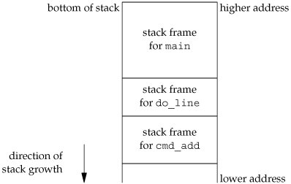
setjmp / longjmp
nonlocal goto
note:在通常的程序中，不要因为炫耀而使用这种技术。
违反结构化的程序设计原则。
应用在底层软件中，或信号处理中。

Slide 80
typedef struct {
unsigned j_sp; // 堆栈指针寄存器
unsigned j_ss; // 堆栈段
unsigned j_flag; // 标志寄存器
unsigned j_cs; // 代码段
unsigned j_ip; // 指令指针寄存器
unsigned j_bp; // 基址指针
unsigned j_di; // 目的指针
unsigned j_es; // 附加段
unsigned j_si; // 源变址
unsigned j_ds; // 数据段
} jmp_buf;
jmp_buf 结构确保使用 longjmp() 后可以跳回到该执行点上继续执行。

Slide 81
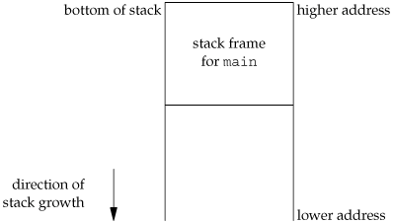
int setjmp(jmp_buf env) ;
return：0 by setjmp，返回0
void longjmp(jmp_buf env, int val) ;
jmp_buf 类型的变量env保存用来恢复栈状态的所有信息。
val：用于指示从setjmp的返回值
Stack frame after longjmp

Slide 82
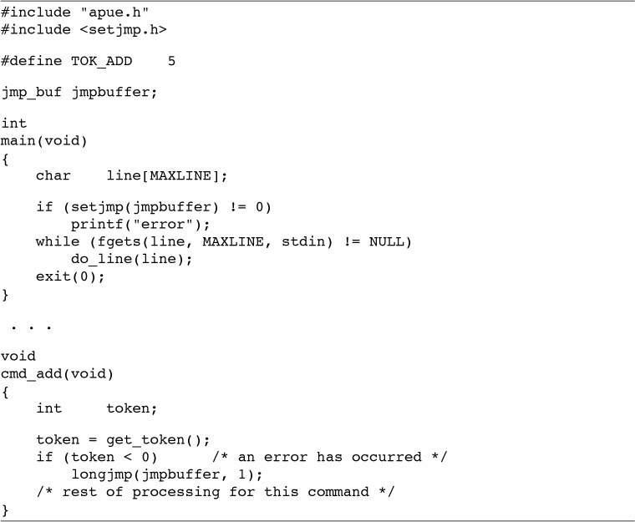
an example for concept

Slide 83
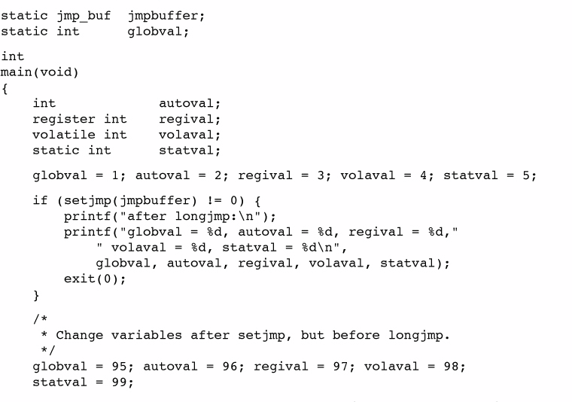
Auto、register、volatile

Slide 84
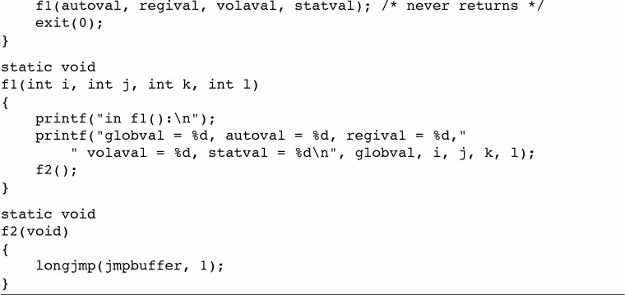
Auto、register、volatile

Slide 85
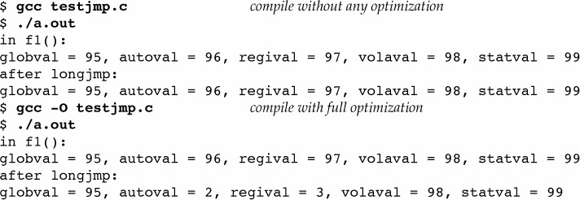
Auto、register、volatile
in f1(): count = 97, val = 98, sum = 99
after longjmp: count = 97, val = 98, sum = 99
$ cc -O testjmp.c //进行全部优化的编译
$ a.out

Slide 86
setjmp结论
优化编译时，所有自动变量都会成为寄存器变量。
对于寄存器变量，恢复为setjmp的值
对于memory（volatile）中的变量，为longjmp时的值
如果要编写一个使用非局部跳转的可移植程序，则必须使用v o l a t i l e属性。

